Slide 1
Finding and using evidence for effective decision-making

Slide 2
Finding and using evidence for effective decision-making
Plan for today
1. An Introduction to Evidence-Informed Decision Making – 0930 - 1000
2. Different Types of Evidence – 1000 - 1100
3. Where to Find Evidence: Tips and Tricks – 1100 – 1200
Lunch break
4. Evaluating Evidence: How to Assess Quality – 1300 – 1400
Coffee break
5. Using Evidence and Uncertainty to Inform Decisions – 1420 – 1520
6. Review of the day – questions/comments welcome – 1520-1530
Go home!
Notes:
0930 – 1500
0930-1000
1000 – 1100
1100 – 1200
1300 – 1400
1400 – 1500

Slide 3
1. An Introduction to Evidence- Informed Decision Making

Slide 4
1.1 What is Evidence-Informed Decision Making?
Evidence-based
Evidence-informed
“the conscientious, explicit and judicious use of the best evidence in making decisions about..” (Sackett et al. 1996)
“the assimilation of professional judgment and research evidence regarding the efficiency of interventions” (McSherry et al., 2002)
“The distinction is useful: the scientific process of systematic review and synthesis is evidence-based but we aim for the policy-making process to be evidence-informed” Haddaway, N., & Pullin, A. (2013). Evidence-based conservation and evidence-informed policy: A response to Adams & Sandbrook. Oryx, 47(3), 336-338. doi:10.1017/S0030605313000811

Slide 5
1.2 What is Evidence-Informed Decision Making?
Environmental decision required
Convert information need into an “answerable question”
Track down “best evidence” for answering the question
“Critically appraise” the evidence for validity, impact and applicability
Integrate the evidence into your decision making
Evaluate the steps before and seek ways to improve the next time
The 4As model
Audit
Ask
Apply
Acquire
Appraise

Slide 6
1.3 What is Evidence-Informed Decision Making?
Environmental decision required
Convert information need into an “answerable question”
Track down “best evidence” for answering the question
“Critically appraise” the evidence for validity, impact and applicability
Integrate the evidence into your decision making
Evaluate the steps before and seek ways to improve the next time
The 4As model
Audit
Ask
Co-production
Decision-maker
Apply
Acquire
Appraise
Evidence synthesist

Slide 7
1.3 What is Evidence-Informed Decision Making?
Environmental decision required
Convert information need into an “answerable question”
Track down “best evidence” for answering the question
“Critically appraise” the evidence for validity, impact and applicability
Integrate the evidence into your decision making
Evaluate the steps before and seek ways to improve the next time
The 4As model
‘In spite of almost universal support in principle for using evidence in decision-making, there was little consensus among participants on what evidence is, what kind of evidence is most appropriate and how “using evidence” can best be demonstrated’
Bowen S, Erickson T, Martens PJ, Crockett S. More than "using research": the real challenges in promoting evidence-informed decision-making. Healthcare Policy. 2009 Feb;4(3):87-102. PMID: 19377360; PMCID: PMC2653695.
Audit
Ask
Co-production
Decision-maker
Apply
Acquire
Appraise
Evidence synthesist

Slide 8
1.4 What is Evidence-Informed Decision Making?
Environmental decision required
Convert information need into an “answerable question”
Track down “best evidence” for answering the question
“Critically appraise” the evidence for validity, impact and applicability
Integrate the evidence into your decision making
Evaluate the steps before and seek ways to improve the next time
The 4As model
Audit
Ask
Keystone
Apply
Acquire
Pinch point 3 – How to use evidence in your decision making?
Appraise
Pinch point 1 – What & where is the evidence?
Pinch point 2 – What kind of evidence is most appropriate?

Slide 9

What does our evidence look like?
The replication crisis
Schooler, J. W. (2014). "Metascience could rescue the 'replication crisis'". Nature. 515 (7525): 9.
Notes:
(or replicability crisis) refers to a methodological crisis in science in which scientists have found that the results of many scientific experiments are difficult or impossible to replicate on subsequent investigation, either by independent researchers or by the original researchers themselves

Slide 10
Empirical evidence
Domain | Findings | Sources
Medicine | Out of 49 highly cited papers, 45 claimed that studied therapy was effective. Of these studies, 16% were contradicted by subsequent studies, 16% had found stronger effects than did subsequent studies, 44% were replicated, and 24% remained largely unchallenged. 11% of pre-clinical cancer studies were replicable | Ioannidis JA (13 July 2005). Contradicted and initially stronger effects in highly cited clinical research. JAMA. 294 (2): 218–228. Begley, CG., and Lee ME., (2012) Drug Development: Raise Standards for Preclinical Cancer Research, Nature. 483, 531–533.
Psychology | Out of 100 studies from high-ranking journals only 36% had significant findings (p value below .05) compared to 97% of the original studies. The mean effect size in the replications was approximately half the magnitude of the effects reported in the original studies. Questionable research practices (QRPs) have been identified as common in the field (majority of 2000 scientists confess to at least one of: e.g. selective reporting, p-hacking, nonpublication of data, post-hoc storytelling (framing exploratory analyses as confirmatory analyses), manipulation of outliers. | Collaboration, Open Science (2015). "Estimating the reproducibility of psychological science". Science. 349 (6251): aac4716. Leslie JK.; Loewenstein, GP, Drazen (2012). "Measuring the Prevalence of Questionable Research Practices With Incentives for Truth Telling". Psychological Science. 23 (5): 524–532
Notes:
Marketing, economics……
Also marketing (Hunter, John E. (2011-06-01). "The desperate need for replications". Journal of Consumer Research. 28 (1): 149–158. doi:10.1086/321953.), economics ( )
False positive conclusions, often resulting from the pressure to publish or the author's own confirmation bias, are an inherent hazard in the field, requiring a certain degree of skepticism on the part of readers. (Simmons, Joseph; Nelson, Leif; Simonsohn, Uri (November 2011). "False-Positive Psychology: Undisclosed Flexibility in Data Collection and Analysis Allows Presenting Anything as Significant". Psychological Science. Washington DC: Association for Psychological Science. 22 (11): 1359–1366. )

Slide 11
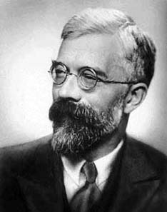
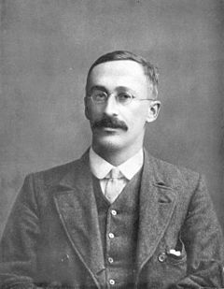
The dance of the P values
Strength of evidence
P<0.001
P<0.01
P<0.05
P 0.05 to ?
P>0.1
The classical P value: The probability of observing data at least as extreme as the actual data given infinite observations….
assuming the null hypothesis to be true
https://www.routledge.com/Introduction-to-the-New-Statistics-Estimation-Open-Science-and-Beyond/Cumming-Calin-Jageman/p/book/9781138825529

Slide 12
The dance of the P values
Strength of evidence | Significance language
P<0.001 | Very highly Significant
P<0.01 | Highly significant
P<0.05 | Significant
P 0.05 to ? | Approaching Significant
P>0.1 | Non-significant
https://www.routledge.com/Introduction-to-the-New-Statistics-Estimation-Open-Science-and-Beyond/Cumming-Calin-Jageman/p/book/9781138825529

Slide 13
The dance of the P values
Strength of evidence | Significance language | Suggests Truth
P<0.001 | Very highly Significant | There is definitely an effect
P<0.01 | Highly significant | There is an effect
P<0.05 | Significant | Most likely there is an effect
P 0.05 to ? | Approaching Significant | Almost? Probably? (but low power)
P>0.1 | Non-significant | No effect?
https://www.routledge.com/Introduction-to-the-New-Statistics-Estimation-Open-Science-and-Beyond/Cumming-Calin-Jageman/p/book/9781138825529

Slide 14
The dance of the P values
Strength of evidence | Significance language | Suggests Truth | Evokes emotion
P<0.001 | Very highly Significant | There is definitely an effect | Elation Exuberance Smugness?
P<0.01 | Highly significant | There is an effect | Dancing, Drinking
P<0.05 | Significant | Most likely there is an effect | Relief Cheerfulness
P 0.05 to ? | Approaching Significant | Almost? Probably? (but low power) | Frustration (if only)
P>0.1 | Non-significant | No effect? | Despair, depression
https://www.routledge.com/Introduction-to-the-New-Statistics-Estimation-Open-Science-and-Beyond/Cumming-Calin-Jageman/p/book/9781138825529

Slide 15
The dance of the P values
Strength of evidence | Significance language | Suggests Truth | Evokes emotion | Implications
P<0.001 | Very highly Significant | There is definitely an effect | Elation Exuberance Smugness? | Nobel Prize Tenure Research Grant
P<0.01 | Highly significant | There is an effect | Dancing, Drinking | **** publication PhD
P<0.05 | Significant | Most likely there is an effect | Relief Cheerfulness | *** publication
P 0.05 to ? | Approaching Significant | Almost? Probably? (but low power) | Frustration (if only) | Stress leave counselling
P>0.1 | Non-significant | No effect? | Despair, depression | Reconsider life goals
https://www.routledge.com/Introduction-to-the-New-Statistics-Estimation-Open-Science-and-Beyond/Cumming-Calin-Jageman/p/book/9781138825529

Slide 16
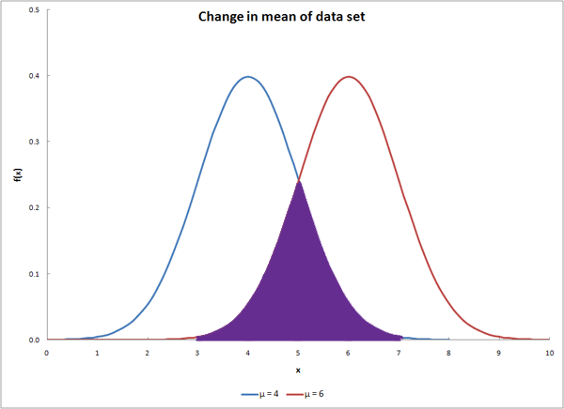
The Dance of the P values
If P values are meaningful and represent the truth they should replicate...
Let’s run a simulation to see if they do…
https://www.youtube.com/watch?v=5OL1RqHrZQ8

Slide 17
Dance of the P values
P values do not replicate
(Over)reliance on P values has serious consequences for the rigour of our science…

Slide 18
1.5 What is Evidence-Informed Decision Making?
Convert information need into an “answerable question”
Needs to be co-produced
Why?
Ensure broad relevance
Set findings in context
Improve readability
Facilitate communication
Endorsement
Prioritise review questions (reduce research waste)
Suggest evidence (reports etc.)

Slide 19
1.6 What is Evidence-Informed Decision Making?
Question formulation
Often an iterative process – starts off broad and needs to be narrowed to be answered
Identify a question that is of greatest interest (to stakeholders, decision-makers etc.)
Identify a question that maximises cost-effectiveness
Identify a question that minimised confusion (avoid vague phrasing)

Slide 20
1.7 What is Evidence-Informed Decision Making?
Question formulation
What type of questions can be asked?
What is the state of the evidence?
“What research evidence is there that humans are exposed to and affected by AMR in the environment?”
What is the effect of an intervention/exposure on a population?
“How do changes in flow magnitude due to hydroelectric power production affect fish abundance and diversity in temperate regions?”
How can we generalise the best available evidence to a larger population/spatial extent?
Greenspaces & human health benefits - multiple systematic reviews but no over-arching understanding of the effects

Slide 21
1.8 What is Evidence-Informed Decision Making?
Question frameworks
PICO – Population Intervention Comparator Outcome
What is the effect of neonicotinoid pesticides on pollinator performance?
PECO – Population Exposure Comparator Outcome
What is the effectiveness of conversion to organic farming on pollinator performance?
PO – Population Outcome(s)
What is the prevalence (ppm) of neonicotinoid pesticides in fresh water?
PIT – Population Index test Target outcome
What is the sensitivity of water tests for presence and level of neonicotinoid pesticides in freshwater streams?

Slide 22
1.8 What is Evidence-Informed Decision Making?
Question frameworks
PICO – Population Intervention Comparator Outcome
What is the effect of neonicotinoid pesticides on pollinator performance?
PECO – Population Exposure Comparator Outcome
What is the effectiveness of conversion to organic farming on pollinator performance?
PO – Population Outcome(s)
What is the prevalence (ppm) of neonicotinoid pesticides in fresh water?
PIT – Population Index test Target outcome
What is the sensitivity of water tests for presence and level of neonicotinoid pesticides in freshwater streams?

Slide 23
1.8 What is Evidence-Informed Decision Making?
Question frameworks
PICO – Population Intervention Comparator Outcome
What is the effect of neonicotinoid pesticides on pollinator performance?
PECO – Population Exposure Comparator Outcome
What is the effectiveness of conversion to organic farming on pollinator performance?
PO – Population Outcome(s)
What is the prevalence (ppm) of neonicotinoid pesticides in fresh water?
PIT – Population Index test Target outcome
What is the sensitivity of water tests for presence and level of neonicotinoid pesticides in freshwater streams?

Slide 24
1.8 What is Evidence-Informed Decision Making?
Question frameworks
PICO – Population Intervention Comparator Outcome
What is the effect of neonicotinoid pesticides on pollinator performance?
PECO – Population Exposure Comparator Outcome
What is the effectiveness of conversion to organic farming on pollinator performance?
PO – Population Outcome(s)
What is the prevalence (ppm) of neonicotinoid pesticides in fresh water?
PIT – Population Index test Target outcome
What is the sensitivity of water tests for presence and level of neonicotinoid pesticides in freshwater streams?

Slide 25
1.8 What is Evidence-Informed Decision Making?
Question frameworks
PICO – Population Intervention Comparator Outcome
What is the effect of neonicotinoid pesticides on pollinator performance?
PECO – Population Exposure Comparator Outcome
What is the effectiveness of conversion to organic farming on pollinator performance?
PO – Population Outcome(s)
What is the prevalence (ppm) of neonicotinoid pesticides in fresh water?
PIT – Population Index test Target outcome
What is the sensitivity of water tests for presence and level of neonicotinoid pesticides in freshwater streams?

Slide 26
1.9 What is Evidence-Informed Decision Making?
Question frameworks – Your turn
How does the size and density of kelp forest affect fisheries in the Pacific?
Are reintroduction programs effective for increasing populations of African wild dogs in South Africa?
What is the impact of flooding on abundance of trout in Chilean rivers?
Population | Intervention/Exposure | Comparator | Outcome

Slide 27
1.10 What is Evidence-Informed Decision Making?
Question frameworks – Your turn
How does the size and density of kelp forest affect fisheries in the Pacific?
Population | Intervention/Exposure | Comparator | Outcome
Population | Exposure | Comparator | Outcome
Pacific Ocean | Kelp forest size and density | Smaller or less dense kelp forests | Fish diversity, abundance, biomass, recruitment, condition, etc.

Slide 28
1.10 What is Evidence-Informed Decision Making?
Question frameworks – Your turn
Are reintroduction programs effective for increasing populations of African wild dogs in South Africa?
Population | Intervention/Exposure | Comparator | Outcome
Population | Exposure | Comparator | Outcome
South Africa | African wild dog reintroduction programs | No reintroduction or before reintroduction | Populations (density)

Slide 29
1.10 What is Evidence-Informed Decision Making?
Question frameworks – Your turn
What is the impact of flooding on abundance of trout in Chilean rivers?
Population | Intervention/Exposure | Comparator | Outcome
Population | Exposure | Comparator | Outcome
Rivers in Chile containing trout | Flooding | Periods with less flooding or rivers with less flooding | Trout abundance

Slide 30
1.10 What is Evidence-Informed Decision Making?
Question frameworks – Your question?
Population | Intervention/Exposure | Comparator | Outcome

Slide 31
2. Different Types of Evidence

Slide 32
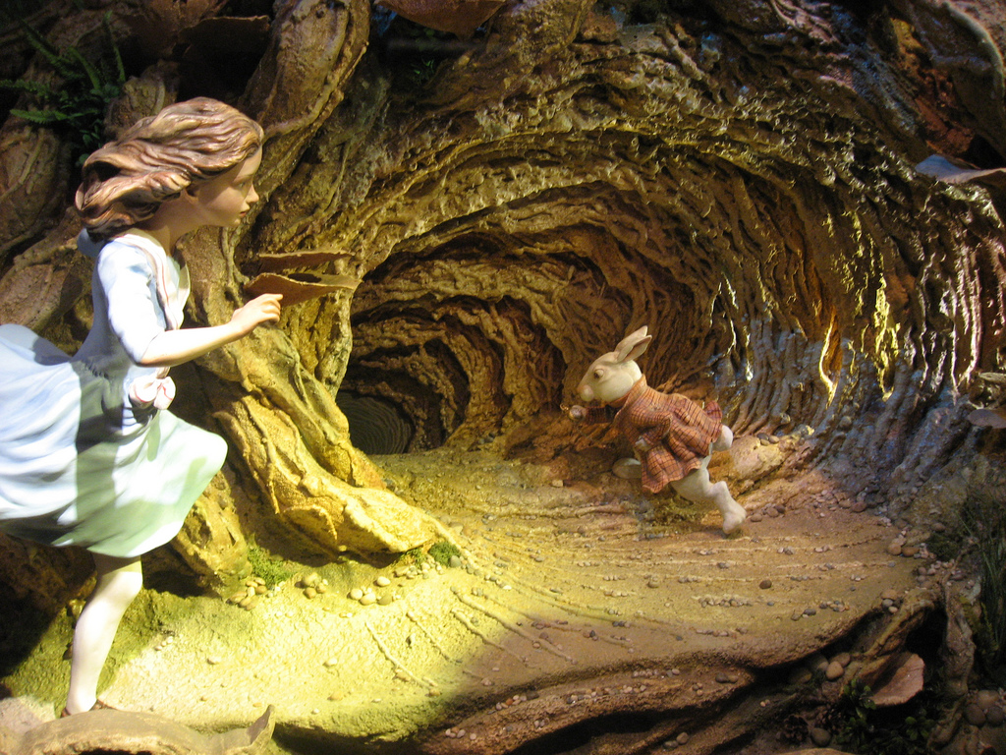
2. Different Types of Evidence
What is “evidence”?
What is “knowledge”?
What is “opinion”?
What is…
What…
This Photo by Unknown Author is licensed under CC BY-SA-NC

Slide 33
2.1 Different Types of Evidence
Adams, W.M. & Sandbrook, C. (2013) Conservation, evidence and policy. Oryx, 47, 329–335.
Haddaway, N., & Pullin, A. (2013). Evidence-based conservation and evidence-informed policy: A response to Adams & Sandbrook. Oryx, 47(3), 336-338.
What counts as evidence?
Overly focused on quantitative data
What counts as evidence?
“…in general any evidence can count, qualitative or quantitative. In our view what matters is fitness for purpose; what form of evidence is relevant for the question being addressed?”

Slide 34
2.1 Different Types of Evidence
Adams, W.M. & Sandbrook, C. (2013) Conservation, evidence and policy. Oryx, 47, 329–335.
Haddaway, N., & Pullin, A. (2013). Evidence-based conservation and evidence-informed policy: A response to Adams & Sandbrook. Oryx, 47(3), 336-338.
What counts as evidence?
“…it is important to note that the formal research literature is not always correct, even when ideas are widely shared”
What counts as evidence?
“It is surely evidence-based medicine that has been one of the most influential drivers in recognizing that not all peer-reviewed literature is reliable or correct”

Slide 35
2.1 Different Types of Evidence
Adams, W.M. & Sandbrook, C. (2013) Conservation, evidence and policy. Oryx, 47, 329–335.
Haddaway, N., & Pullin, A. (2013). Evidence-based conservation and evidence-informed policy: A response to Adams & Sandbrook. Oryx, 47(3), 336-338.
What counts as evidence?
“The decisions taken by scientists undertaking evidence-based reviews in judging ‘good knowledge’ are careful but also socially constructed and vulnerable to false certainties”
What counts as evidence?
This is why systematic review methodology is so valuable in demanding objectivity and transparency in the conduct of reviews.

Slide 36
2.1 Different Types of Evidence
Adams, W.M. & Sandbrook, C. (2013) Conservation, evidence and policy. Oryx, 47, 329–335.
Haddaway, N., & Pullin, A. (2013). Evidence-based conservation and evidence-informed policy: A response to Adams & Sandbrook. Oryx, 47(3), 336-338.
What counts as evidence?
“Expertise does not reside solely with scientists or professionals, even if the expertise of less qualified people is not recognized by certification”
What counts as evidence?
Pullin & Salafsky (2010) call for more information to be recorded by practitioners. Similarly, Pullin et al. (2004) do not state that expert knowledge should be replaced by EBC, rather that some traditional knowledge and expert opinion may suffer the same biases and confounders as individual primary research. The case for including local and expert knowledge is well made and, when appropriate, it is what EBC seeks to do. Most obviously this is done in the consultation stage during question formulation when the CEE Guidelines advocate that all relevant stakeholders should be consulted.

Slide 37
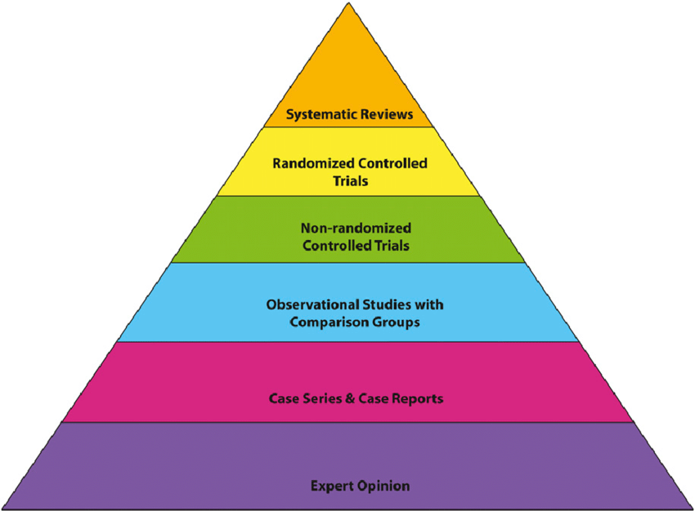
2.2 Different Types of Evidence
Evidence pyramid/Evidence Hierarchy

Slide 38
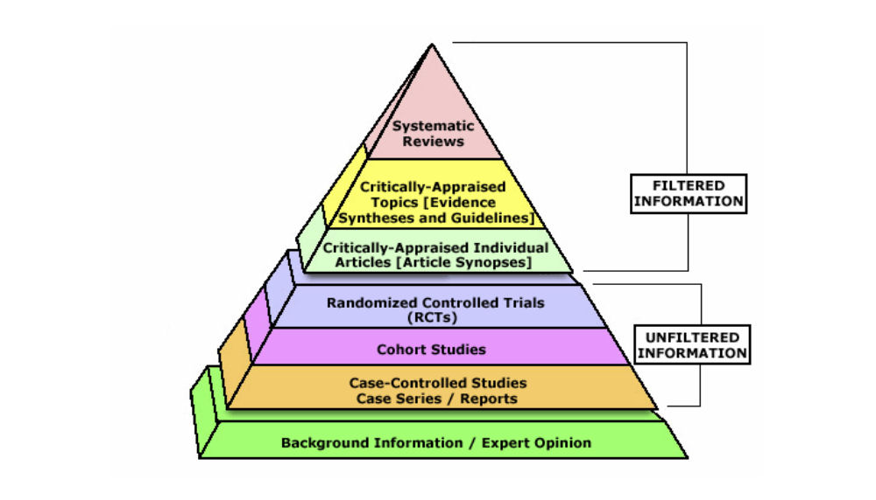
2.2 Different Types of Evidence
Evidence pyramid/Evidence Hierarchy

Slide 39
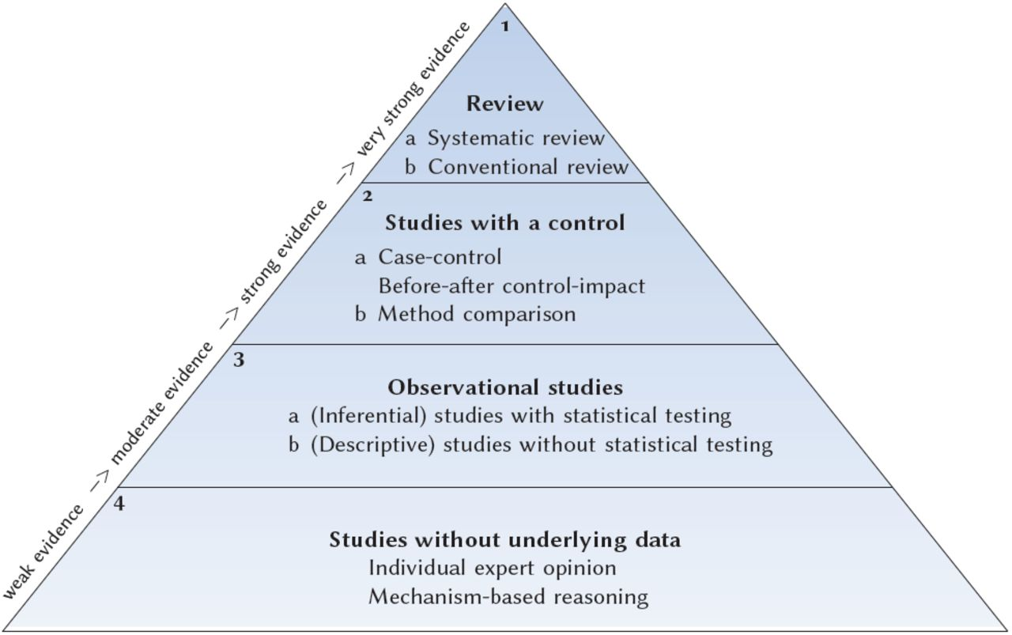
2.2 Different Types of Evidence
Evidence pyramid/Evidence Hierarchy
Mupepele, A.-C., Walsh, J.C., Sutherland, W.J. and Dormann, C.F. (2016), An evidence assessment tool for ecosystem services and conservation studies. Ecol Appl, 26: 1295-1301. https://doi.org/10.1890/15-0595
Notes:
A

Slide 40
2.2 Different Types of Evidence
Evidence pyramid/Evidence Hierarchy
Mupepele, A.-C., Walsh, J.C., Sutherland, W.J. and Dormann, C.F. (2016), An evidence assessment tool for ecosystem services and conservation studies. Ecol Appl, 26: 1295-1301. https://doi.org/10.1890/15-0595
Notes:
A

Slide 41
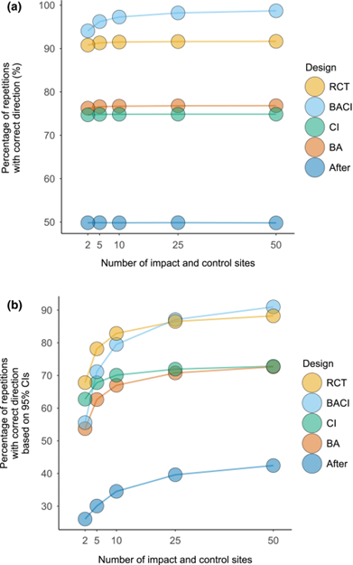
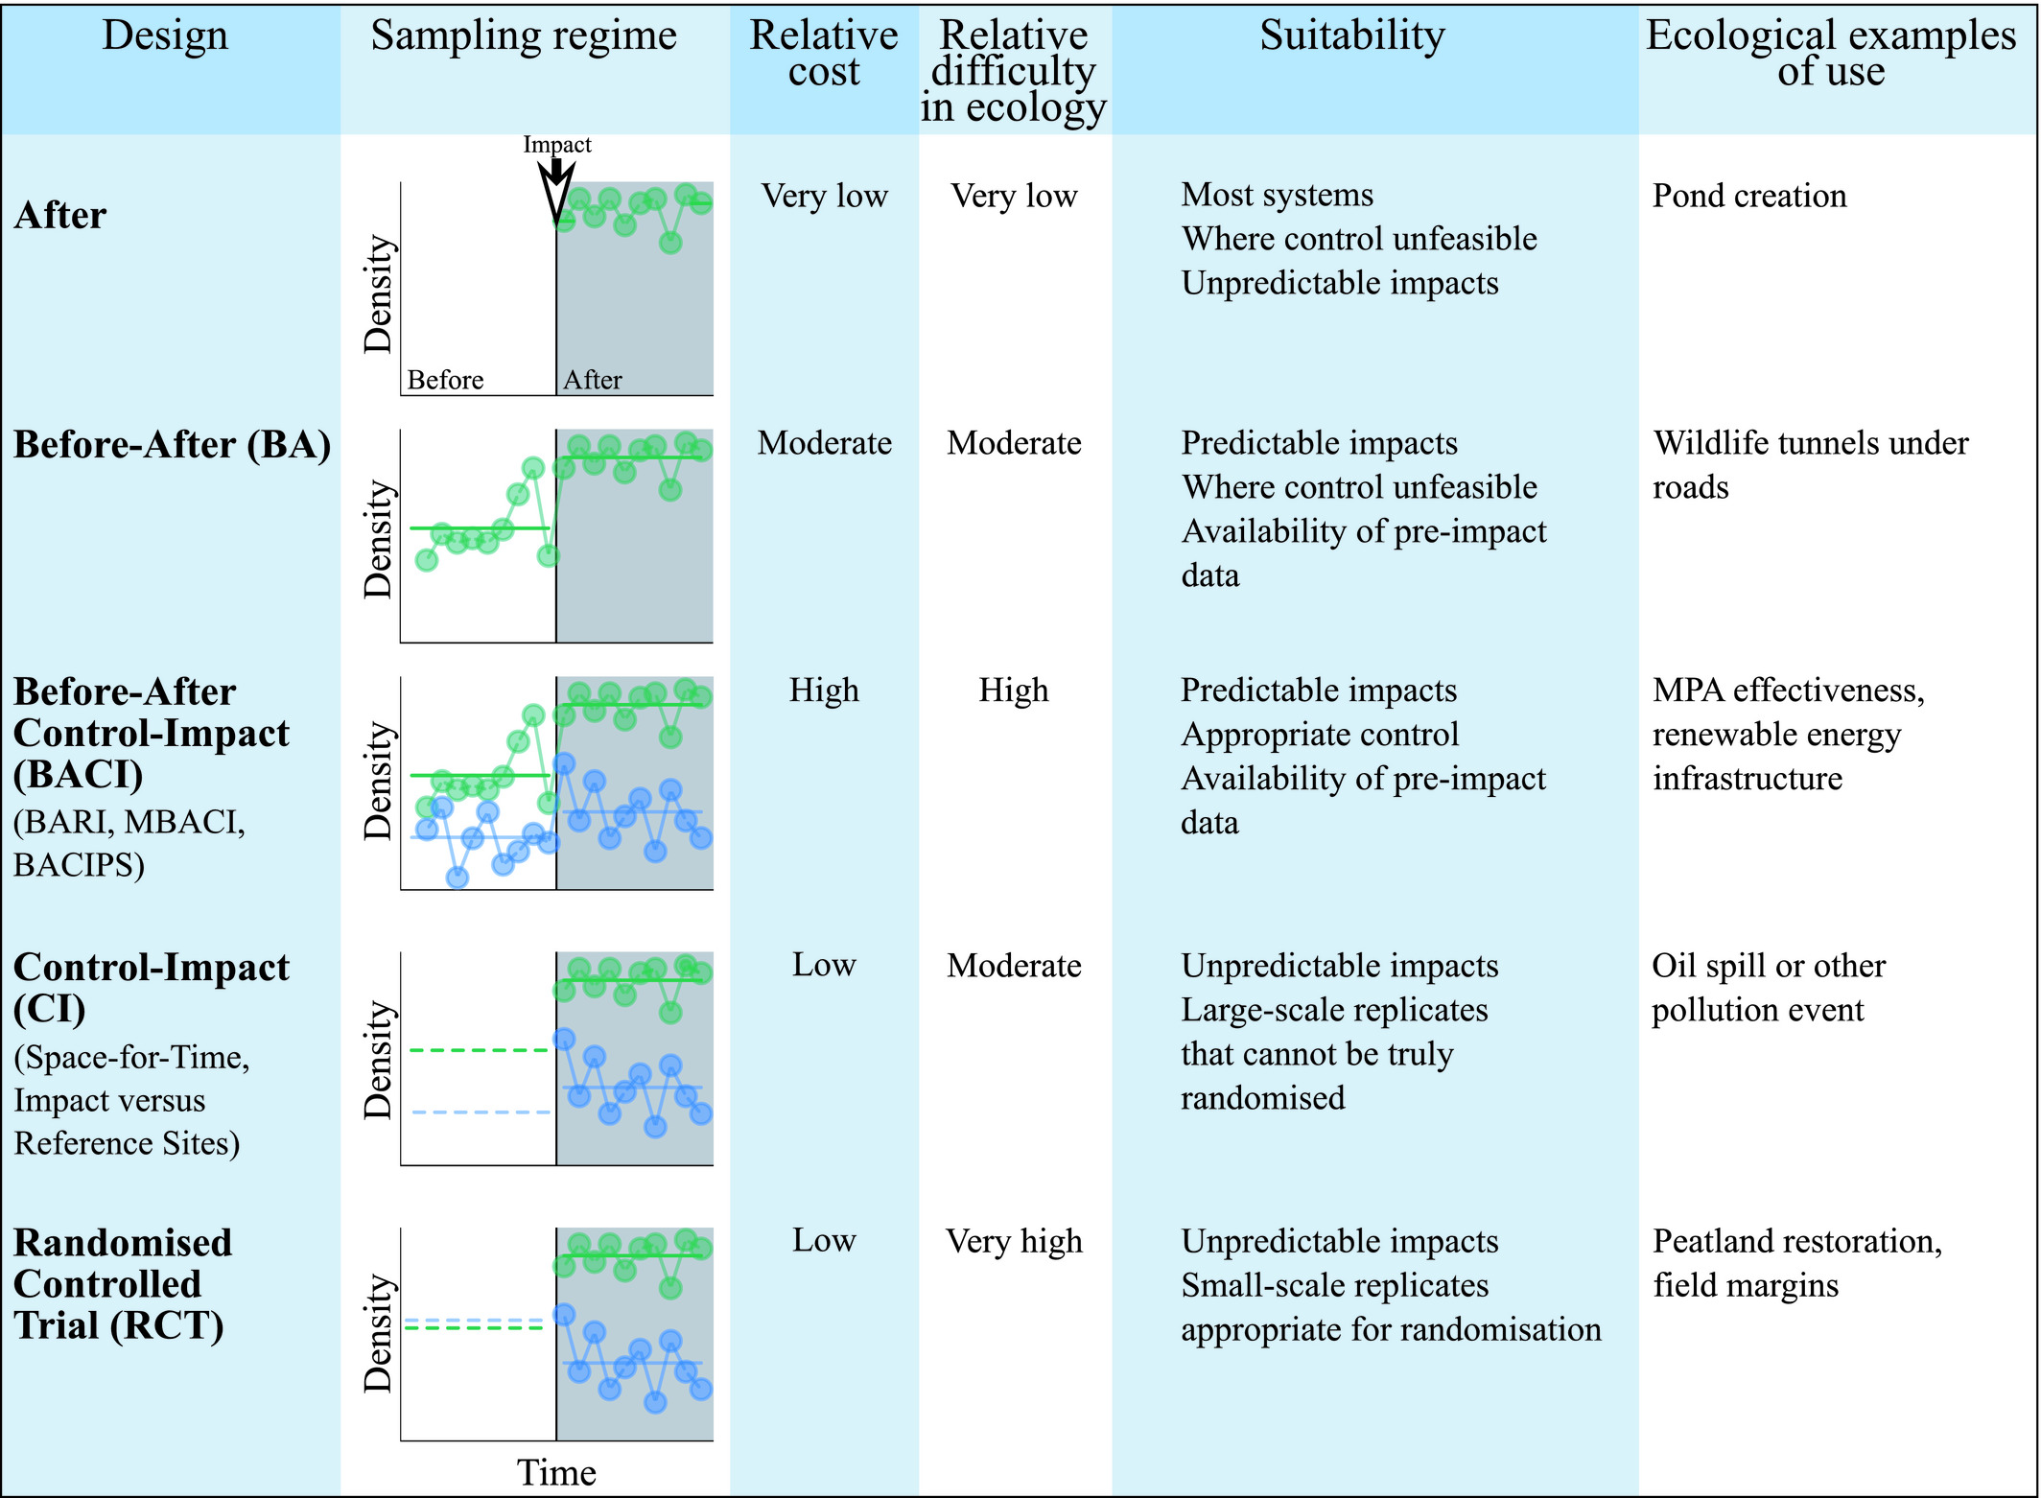
2.2 Different Types of Evidence
Pescott & Stewart (2022), J Appl Ecol, 59: 1187-1190. https://doi.org/10.1111/1365-2664.14153
Performance of designs in correctly predicting the direction of the true effect for multiple levels of spatial replication with equal numbers of control and impact sites Part (a) measures this in terms of whether the effect size estimate was positive or negative, while part (b) considers whether the 95% CIs of this estimate correctly fell entirely above or below zero.
Christie, et al. 2019. J Appl Ecol.; 56: 2742–2754. https://doi.org/10.1111/1365-2664.13499
Notes:
A

Slide 42
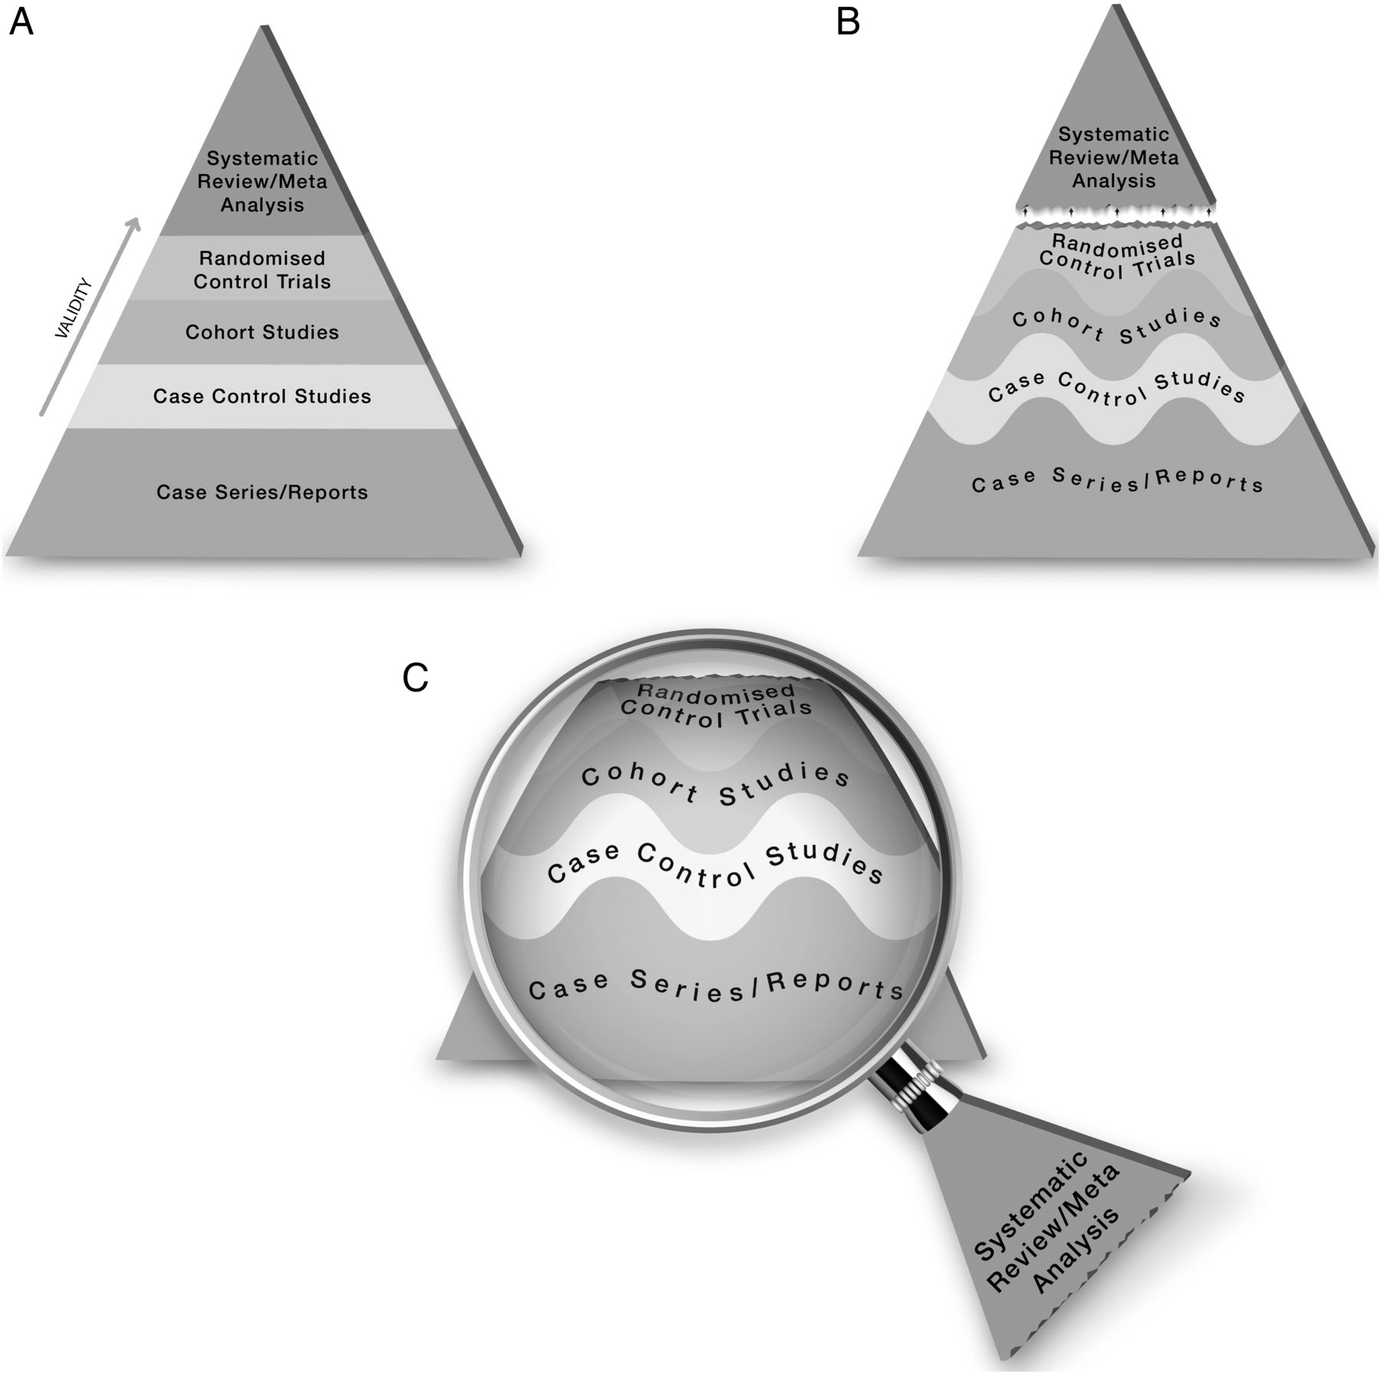

2.2 Different Types of Evidence
The proposed new evidence-based medicine pyramid.
M Hassan Murad et al. Evid Based Med 2016;21:125-127
©2016 by BMJ Publishing Group Ltd

Slide 43
2.3 Different Types of Evidence
Evidence synthesis methods
Systematic Review
Systematic Map
Rapid Review
Review of reviews/Umbrella
Meta-analysis
Qualitative reviews
Etc.

Slide 44
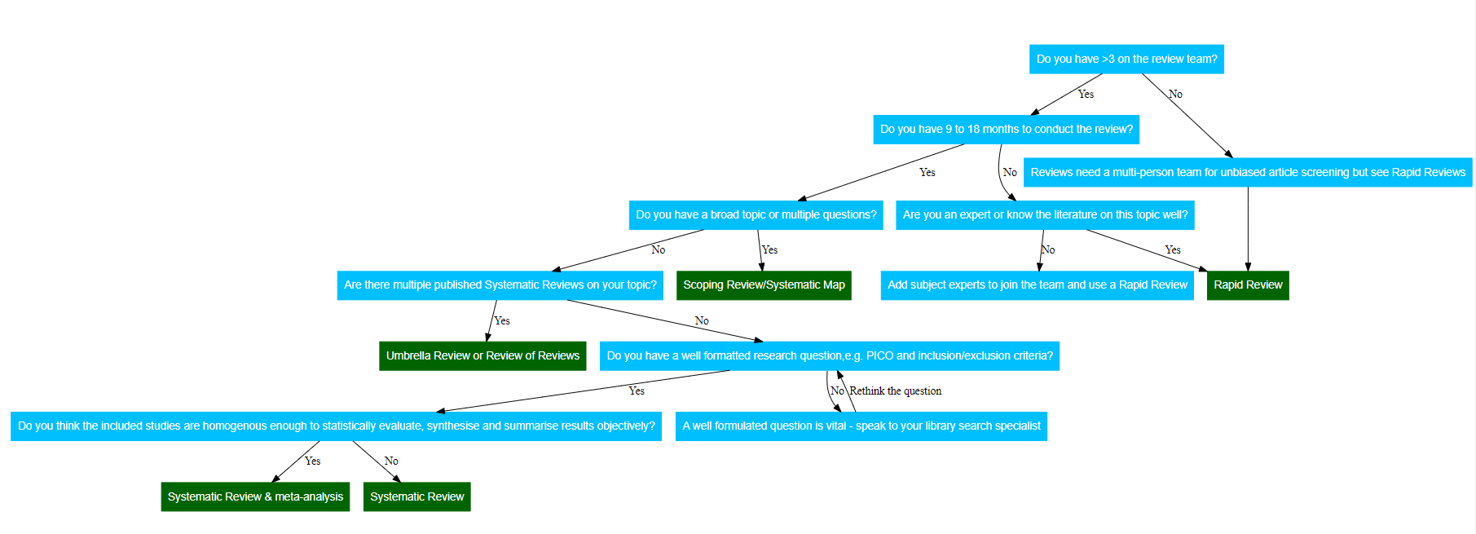
Don’t use “umbrella reviews” or “maps” if you want to know how something works
Don’t use “rapid reviews” or “traditional reviews” if you care about rigour
Don’t use “systematic reviews/meta-analysis” if you do not have resources or money

Slide 45
2.3 Different Types of Evidence
What is the difference between traditional reviews, systematic maps and systematic reviews?

Slide 46



What is the effect of logging on biodiversity?

Slide 47








Slide 48
Traditional Review

Slide 49
Systematic map

Slide 50
Systematic review

Slide 51
Systematic review
We cannot rely on the direction of effect alone – we need to look at the effect size

Slide 52
Study 1
Study 2
Study 3
Study 4
Study 5
Summary
Favours Forest
Favours logged sites

Slide 53
2.3 Different Types of Evidence
Rapid reviews
No agreed definition of a “rapid review”
Which corners to cut (not exhaustive)?
Span of the literature (e.g. post 2010 - present)
“Study quality” (e.g. only systematic reviews?)
Number of reviewers (e.g. 1 person to review & 1 to check a %)

Slide 54
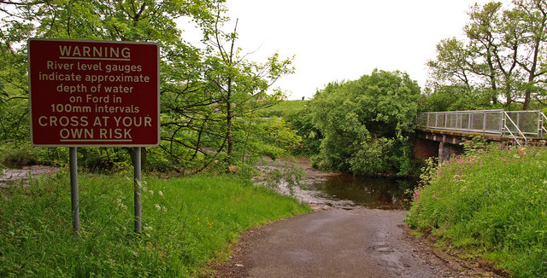
2.3 Different Types of Evidence
WARNING
Systematic reviews can be poor quality and need to be assessed before use
USE THEM (WITHOUT CRITICAL APRAISAL) AT YOUR OWN RISK
This Photo by Unknown Author is licensed under CC BY-SA

Slide 55
3. Where to Find Evidence: Tips and Tricks

Slide 56
3. Where to Find Evidence: Tips and Tricks
True or False
I would go to GoogleScholar first when searching for evidence
Web of Science is more comprehensive than Google Scholar
Web of Science is a transparent, repeatable resource
Grey literature is defined as anything unpublished and not peer-reviewed
Notes:
Okay to Go to GS – not a bibliographic database but good for finding papers
Supplemental source of information – algorithm hidden – different people in difference places will get different results
WOS is not a database; it is a platform. Different institutes will have different subscriptions. WOS core collection is a database – catalogues academic work – journals and publishers that are selected to be included
GS is larger but searches for anything that looks like academic work
WOS is transparent and repeatable as long as you record the databases available and the dates available to your institute (screenshot this)
Grey lit is “anything published by any organisation whose prime purpose is not academic” – anything on the internet is published and some organisation to peer-review

Slide 57
3. Where to Find Evidence: Tips and Tricks
Searches
Comprehensive, transparent, objective
Multiple academic databases
Tried and tested search string
Multiple sources of grey literature
Languages
Documented in detail – all decisions described and explained

Slide 58
3. Where to Find Evidence: Tips and Tricks
Searches
Planning
Where to search
Select databases, choose other resources
How to search
Build a search string, adapt to each resource
Test the search strategy beforehand
Check comprehensiveness
“Benchmark articles”

Slide 59
3. Where to Find Evidence: Tips and Tricks
Where to search
Bibliographic databases
WOS, Scopus, PubMed
Web-based searches
Google, GoogleScholar
Grey literature searches
Organisational websites
Thesis repositories
Notes:
Grey lit limits publication bias

Slide 60
3. Where to Find Evidence: Tips and Tricks
Bibliographic databases
WoS
Scopus
Agricola
AGRIS (FAO)
Academic Search Premier
Biological Abstracts
CAB Abstracts
Lens.org
CEE 2012-2017 Systematic review – mean = 9 (2 – 75) databases. Search between 8-15 databases (broad and specific
Notes:
Grey lit limits publication bias

Slide 61
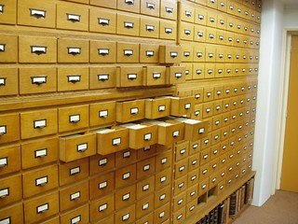
3. Where to Find Evidence: Tips and Tricks
Two types of Grey literature
File drawer research
Academic research which is not published
Theses, unwritten results, negative or non-significant results
Practitioner-generated research
Not intended for academic publishers
Internal reports, consultancy reports
This Photo by Unknown Author is licensed under CC BY
Notes:
Grey lit limits publication bias

Slide 62
3. Where to Find Evidence: Tips and Tricks
Two types of Grey literature
File drawer research
Academic research which is not published
Theses, unwritten results, negative or non-significant results
Practitioner-generated research
Not intended for academic publishers
Internal reports, consultancy reports
File drawer research
Calls for evidence
Theses databases (eThOS)
Google Scholar
Pre-print servers
Practitioner-generated research
Calls for evidence
Organisational websites
Google Scholar
CEE reviews – mean =19 (0-86) websites
Notes:
Grey lit limits publication bias

Slide 63
3. Where to Find Evidence: Tips and Tricks
Search definitions
Search terms (synonyms)
Words used to ensure different terminology is captured by the search
(Substring)
Group related synonyms
Search string
A set of terms entered to a search facility (contains different substrings)
Search strategy
All the methods used to search for evidence (databases, grey literature, calls for evidence)
Notes:
Grey lit limits publication bias

Slide 64
3. Where to Find Evidence: Tips and Tricks
Sensitivity vs Specificity
Balance between number of results retrieved and resources
Sensitivity: getting more potentially relevant material (increase by using broader search terms)
Specificity: proportion of captured material that is relevant (increase by using narrow search terms)
Notes:
Grey lit limits publication bias

Slide 65
3. Where to Find Evidence: Tips and Tricks
Optimise search
Database generally search for keywords in TITLE, ABSTRACT and KEYWORDS
Think how abstracts are written- How are concepts written about
Databases often have a range of search options – simple to advanced
Databases use phrasing and Boolean searches differently
ASK A LIBRARIAN!!!
Notes:
Full text search looks across all the text including reference – increase sensitivity and reducing specificity

Slide 66
3. Where to Find Evidence: Tips and Tricks
Basic search
Built around the question elements
Population
Intervention
Comparator
Outcome
Notes:
Full text search looks across all the text including reference – increase sensitivity and reducing specificity

Slide 67
3. Where to Find Evidence: Tips and Tricks
Basic search
Built around the question elements
Population
Intervention
Comparator
Outcome
How effective is wetland restoration for reducing nitrogen and phosphorus?
Notes:
Full text search looks across all the text including reference – increase sensitivity and reducing specificity

Slide 68
3. Where to Find Evidence: Tips and Tricks
Basic search
Built around the question elements
Population wetland
Intervention restoration
Comparator
Outcome nitrogen, phosphorous
How effective is wetland restoration for reducing nitrogen and phosphorus?
Notes:
Full text search looks across all the text including reference – increase sensitivity and reducing specificity

Slide 69
3. Where to Find Evidence: Tips and Tricks
Boolean operators
OR terms (synonyms)
Wetland OR bog
AND terms (restrictors)
Wetland AND restoration
Quotation marks = “Phrases”
“Wet meadow”
Wildcards (word variations)
Phosph*[phosphate, phosphorus]
NOT not advised
Notes:
Full text search looks across all the text including reference – increase sensitivity and reducing specificity

Slide 70
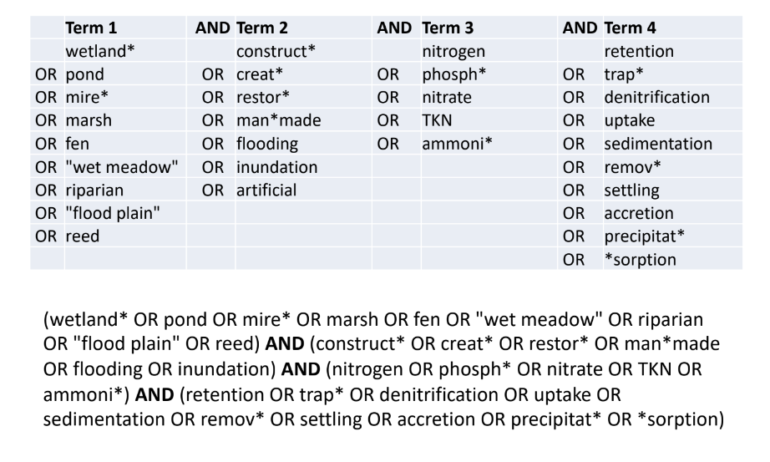
3. Where to Find Evidence: Tips and Tricks
Example search
Notes:
Full text search looks across all the text including reference – increase sensitivity and reducing specificity

Slide 71
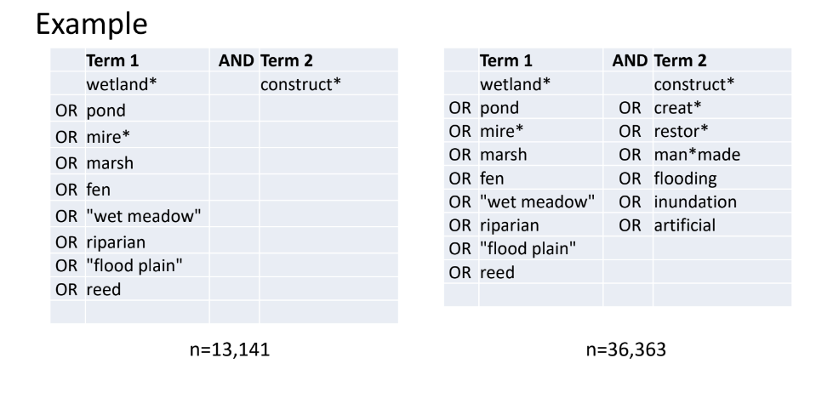
3. Where to Find Evidence: Tips and Tricks
Test search terms individually and build up a string

Slide 72
3. Where to Find Evidence: Tips and Tricks
Test search terms individually and build up a string

Slide 73
3. Where to Find Evidence: Tips and Tricks
Checking the search
Use known studies to benchmark the search against
Bibliographic checking
Citation chasing (pearl growing, snow-ball searching, etc.)

Slide 74
3. Where to Find Evidence: Tips and Tricks
Document the search
Which databases (not just the search platforms)?
Name, URL, date range, subscriptions, your institute name, etc.
Which websites?
Name, URL
What options used?
Search terms
Date ranges
When you searched?
Who searched?

Slide 75
3. Where to Find Evidence: Tips and Tricks
Data management
Search results are data
Search strategy is metadata
Use reproducible workflows
File format – RIS files are useful for exchange between software
Keep track of where files come from (which databases)
Use a file management or review management tool (e.g. Rayyan)

Slide 76
3. Where to Find Evidence: Tips and Tricks
Citation chasing with R
citationchaser (shinyapps.io)
Data management with R
Analyze the Utility of Information Sources and Retrieval Methodologies for Evidence Synthesis • CiteSource (eshackathon.org)
Review management
https://rayyan.ai/reviews

Slide 77
4. Evaluating Evidence: How to Assess Quality

Slide 78
4. Evaluating Evidence: How to Assess Quality
Critical appraisal
Checking both internal and external validity
Internal – are the conclusions of the paper based on sound causality
External – does the paper really fit with my question

Slide 79
4. Evaluating Evidence: How to Assess Quality
How do we do it?
All possible sources of bias, error or uncertainty
Are the outcome measures used appropriate/accurate?
Is a suitable comparator present?
How were treatments assigned (randomisation)?
What is the level of replication?
What is the study design? (BA, CI, BACI, RCT, experimental, observational)
Are baseline measures included?
Are there systematic differences between groups?
Are there potential confounding variables?

Slide 80
4. Evaluating Evidence: How to Assess Quality
How do we do it?
Lots of tools (none of them 100 % reusable!)
Checklists
Questions about validity (“yes”, “no” or “unclear”)
Have in mind what the “optimum” study would be
What is the overall validity? “High” “Low” “Unclear”

Slide 81
4. Evaluating Evidence: How to Assess Quality
What to do when we have done it?
Exclude low quality studies
Use CA to add context to the results
Use sensitivity analysis (include/exclude low quality)
Subgroup analysis

Slide 82
4. Evaluating Evidence: How to Assess Quality
Things to consider
Adapt existing tools
Provide logical rational for the approach
Use CA to inform the results
Validity not quality
Conduct of the science NOT reporting of the science (which is annoying but does not reflect the validity of a study – we just might not know!)
Try to think about all possible threats to validity
This is hard – do not just copy the previous review (as no doubt it can be improved)

Slide 83
4. Evaluating Evidence: How to Assess Quality
Critical Appraisal of studies Exercise

Slide 84
4. Evaluating Evidence: How to Assess Quality
Critical Appraisal of systematic reviews
Not all systematic reviews are Systematic Reviews
You need to assess the quality of the review
CEEDER Database – Environmental Evidence
Critical Appraisal of reviews exercise

Slide 85
5. Using Evidence and Uncertainty to Inform Decisions

Slide 86
5. Using Evidence and Uncertainty to Inform Decisions
Giving decision-makers a pooled effect size or a biased assessment of the evidence should not be tolerated (looking at you Editors and Reviewers of Journals etc.)
What are typical synthesis textual outputs (which are useful)?
What are typical synthesis visual outputs?
Where can we do much better?
How can we help in the decision-process itself (with quantitative evidence)?
Notes:
There seems to be a “’Pass the buck’, ‘or don’t give a f##k’” approach to Evidence Synthesis in Conservation and the Environment

Slide 87
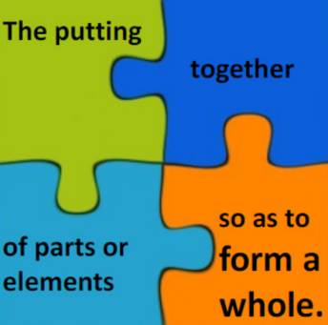
5. Using Evidence and Uncertainty to Inform Decisions
Typical Evidence Synthesis outputs
Narrative synthesis
Quantitative synthesis
Qualitative synthesis
Transparent
Minimise bias
Avoid vote-counting
Account for varying reliability of the evidence

Slide 88
5. Using Evidence and Uncertainty to Inform Decisions
Typical Evidence Synthesis outputs
Two modes of synthesis
Aggregative
Collating information
Summary effect estimate
What? How much?
Configurative
Interpretive
Conceptual frameworks
Model-building
How? Why?

Slide 89
5. Using Evidence and Uncertainty to Inform Decisions
Typical Evidence Synthesis outputs
Narrative synthesis
Text summary of findings
Must go beyond description of individual studies
What does the body of evidence say?
How robust are the findings?

Slide 90
5. Using Evidence and Uncertainty to Inform Decisions
Typical Evidence Synthesis outputs
Narrative synthesis – What is it?
Results and descriptions of studies
Effect size for each comparison and outcome of interest
Description of context
Study design/Methods
Intervention/Exposure
Population/Setting
Summary of methodological robustness

Slide 91
5. Using Evidence and Uncertainty to Inform Decisions
Typical Evidence Synthesis outputs
Narrative synthesis – How to do it?
Separate tables/figures for main categories [Visualisations]
Intervention
Outcome
Species
Group studies
Study design
Susceptibility to bias
Length of investigation
Seasons
Develop groups before data extraction
Meaningful boundaries

Slide 92
5. Using Evidence and Uncertainty to Inform Decisions
Typical Evidence Synthesis outputs
Narrative synthesis – How to do it?
Use the tables/groupings to identify
Themes and trends
Consistency of effect
Study clusters
Patterns of factors
Need to take into account direction and magnitude of effect
Avoid vote counting
Consistency of findings across studies (if not why not)
Give more weight to the better quality studies

Slide 93
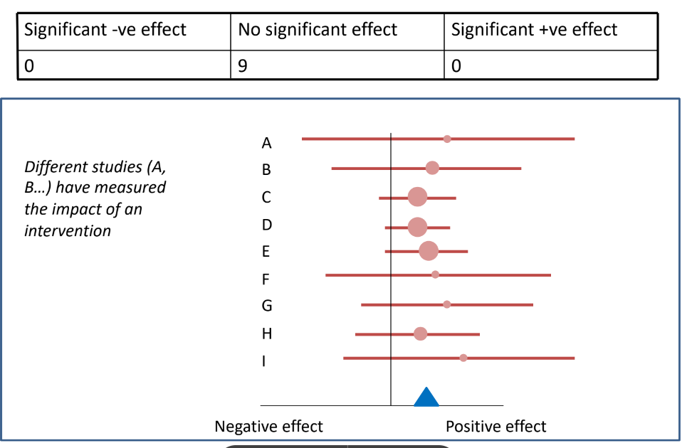
5. Using Evidence and Uncertainty to Inform Decisions
Vote counting

Slide 94
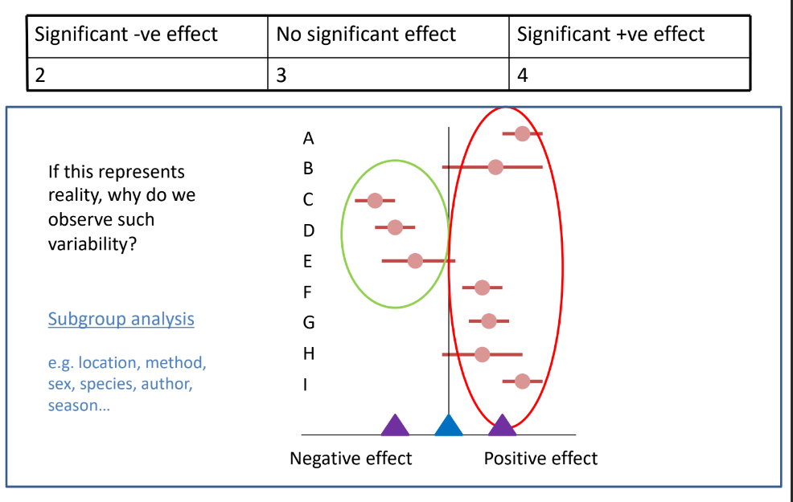
5. Using Evidence and Uncertainty to Inform Decisions
Vote counting

Slide 95
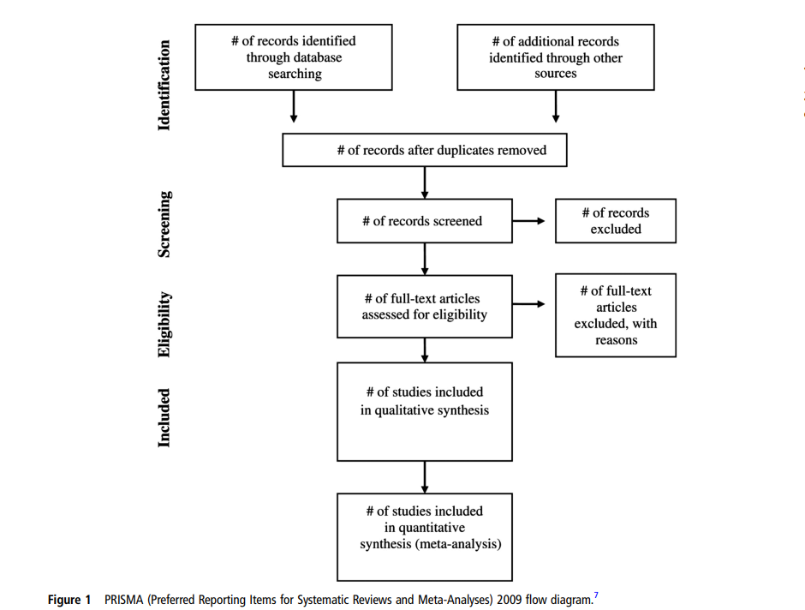
5. Using Evidence and Uncertainty to Inform Decisions
Key data viz
Report the synthesis
Kiran A, et al. Heart 2017;103:19–23. doi:10.1136/heartjnl-2016-309685

Slide 96
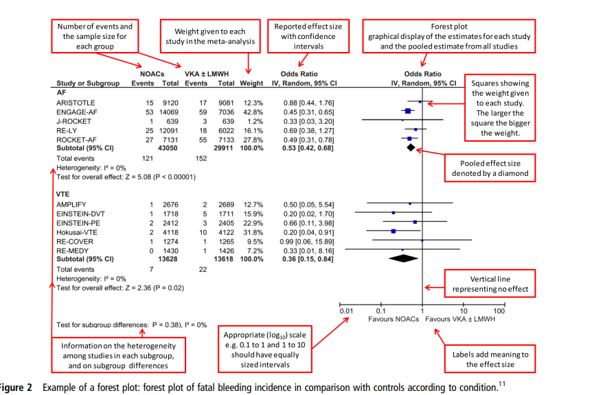
5. Using Evidence and Uncertainty to Inform Decisions
Key data viz
Forest plot
Kiran A, et al. Heart 2017;103:19–23. doi:10.1136/heartjnl-2016-309685

Slide 97
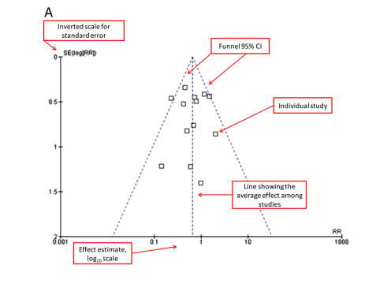
5. Using Evidence and Uncertainty to Inform Decisions
Key data viz
Funnel plot
Kiran A, et al. Heart 2017;103:19–23. doi:10.1136/heartjnl-2016-309685

Slide 98
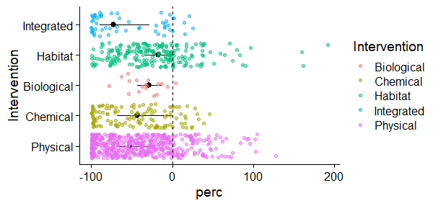
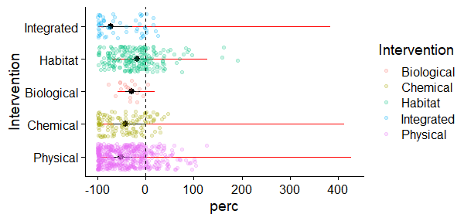
5. Using Evidence and Uncertainty to Inform Decisions
Show the data
Notes:
The prediction interval can be defined as the interval in which the effect size of a new study would fall if this study was selected at random from the same population of the studies already included in the meta-analysis. This gives some indication of the uncertainty in the pooled estimate.

Slide 99
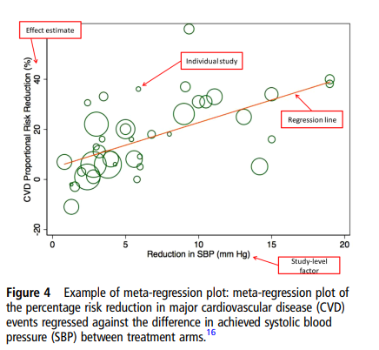
5. Using Evidence and Uncertainty to Inform Decisions
Key data viz
Meta-regression
Kiran A, et al. Heart 2017;103:19–23. doi:10.1136/heartjnl-2016-309685

Slide 100
5. Using Evidence and Uncertainty to Inform Decisions
Key data viz
Evidence atlases for Systematic maps
estech.shinyapps.io/eviatlas/

Slide 101
5. Using Evidence and Uncertainty to Inform Decisions
What can we do much better?
Typical outputs are still quite difficult to use in decision making
Typical outputs are still difficult to understand

Slide 102
5. Using Evidence and Uncertainty to Inform Decisions
What can we do much better?
Plain language summaries
Guidelines

Slide 103
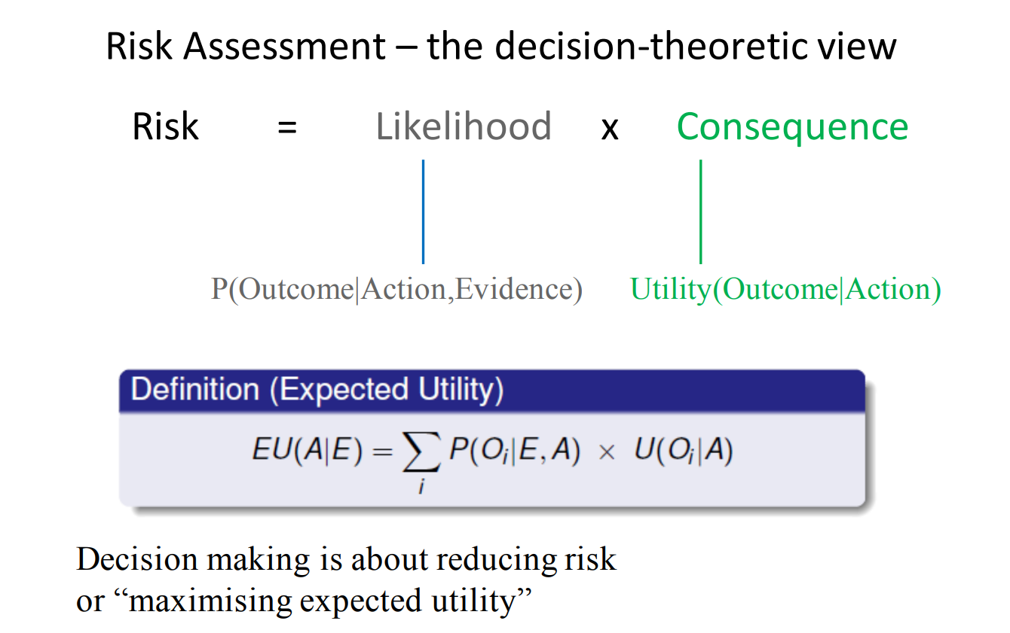
5. Using Evidence and Uncertainty to Inform Decisions
What can we do much better?
Decision models

Slide 104
SR or Meta-analysis
Intervention A
Outcome
Decision

Slide 105
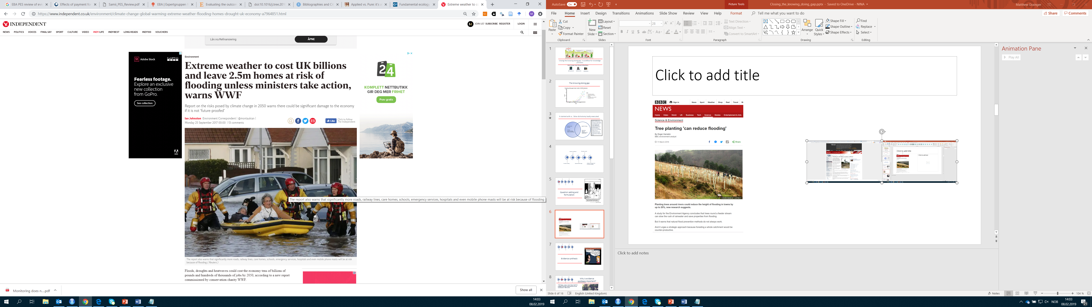
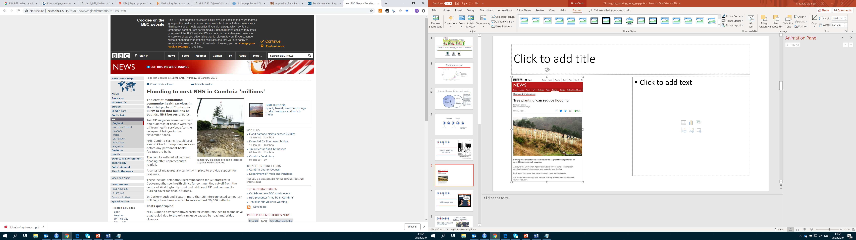
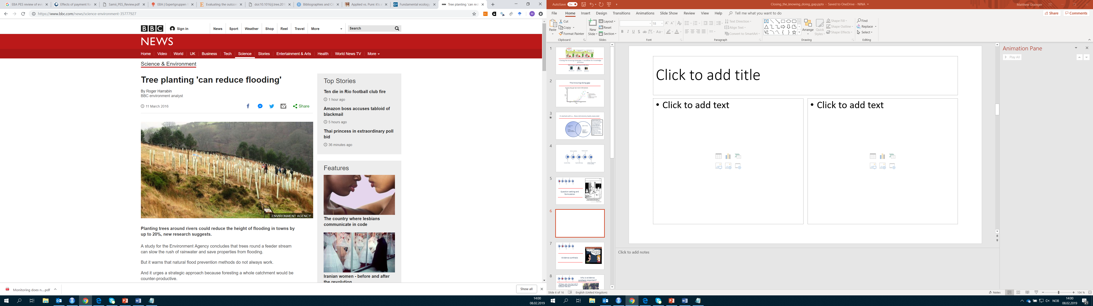
Notes:
Floods have massive implications in terms of cost. Lives and livelihoods are damaged by floods. What interventions work. Recently the UK EA suggested that planting trees could help solve the flooding crisis in the north of England. So our question is can planting trees reduce flooding

Slide 106
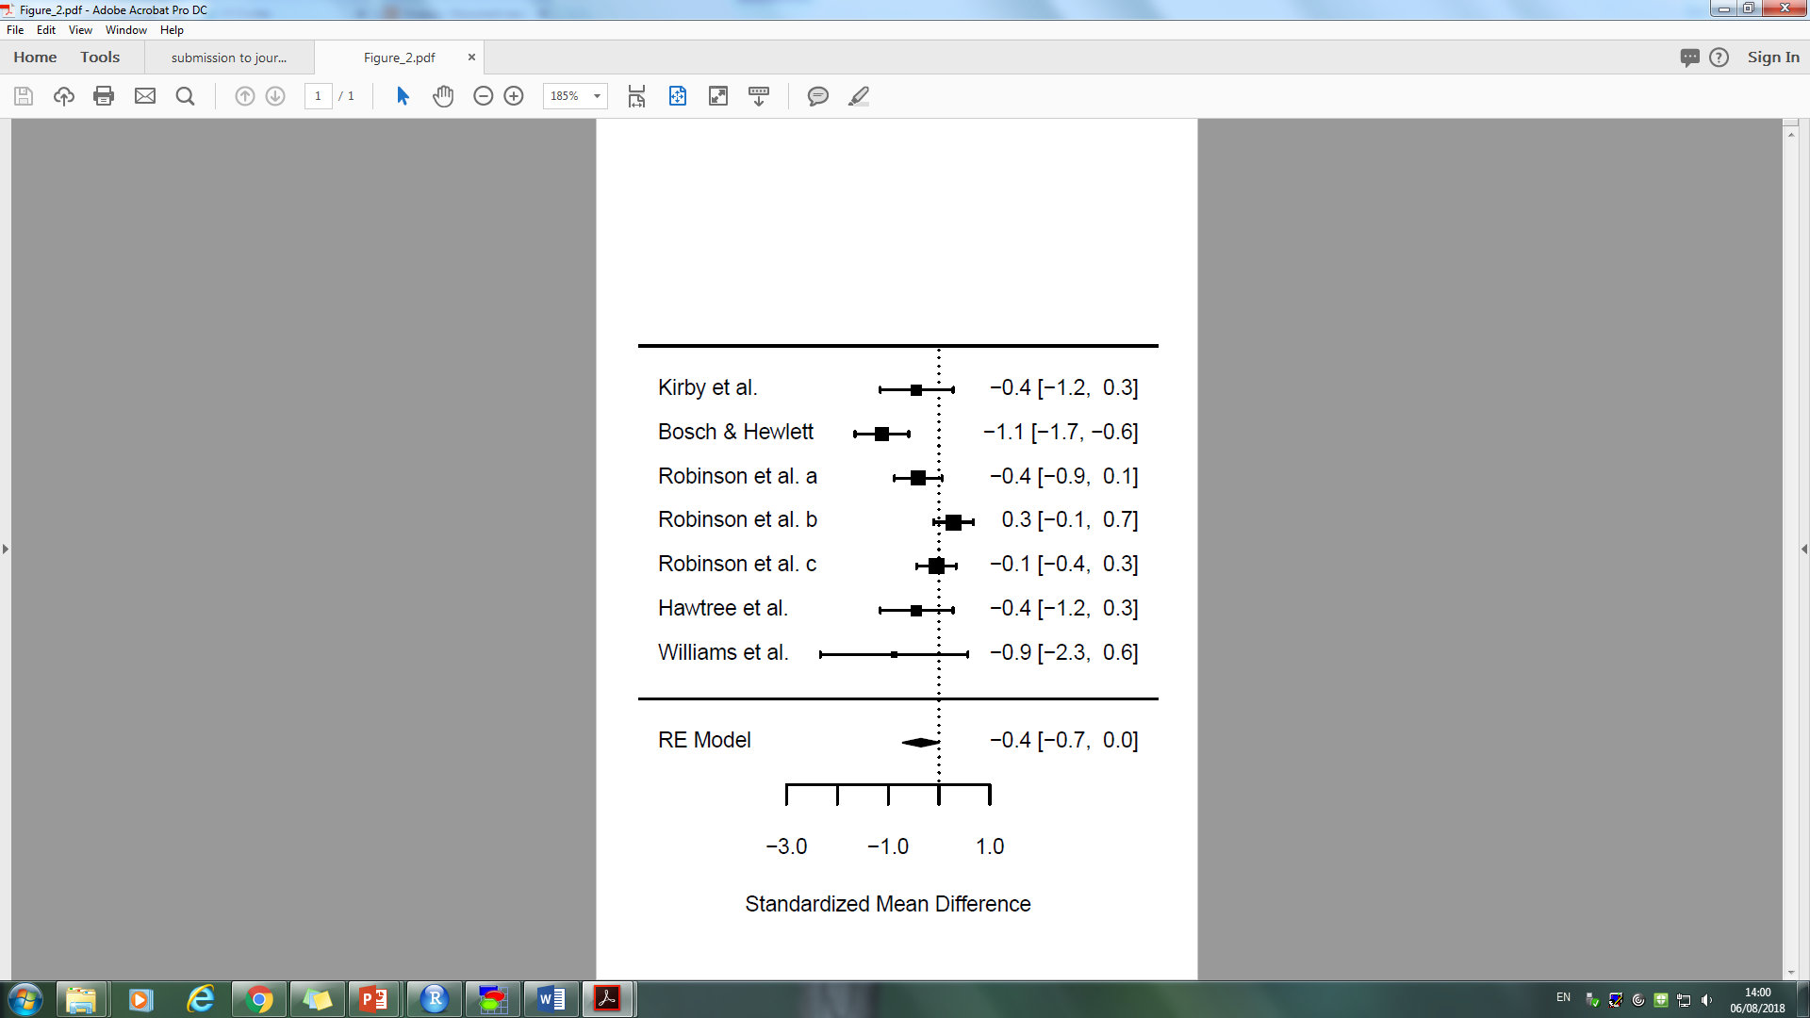
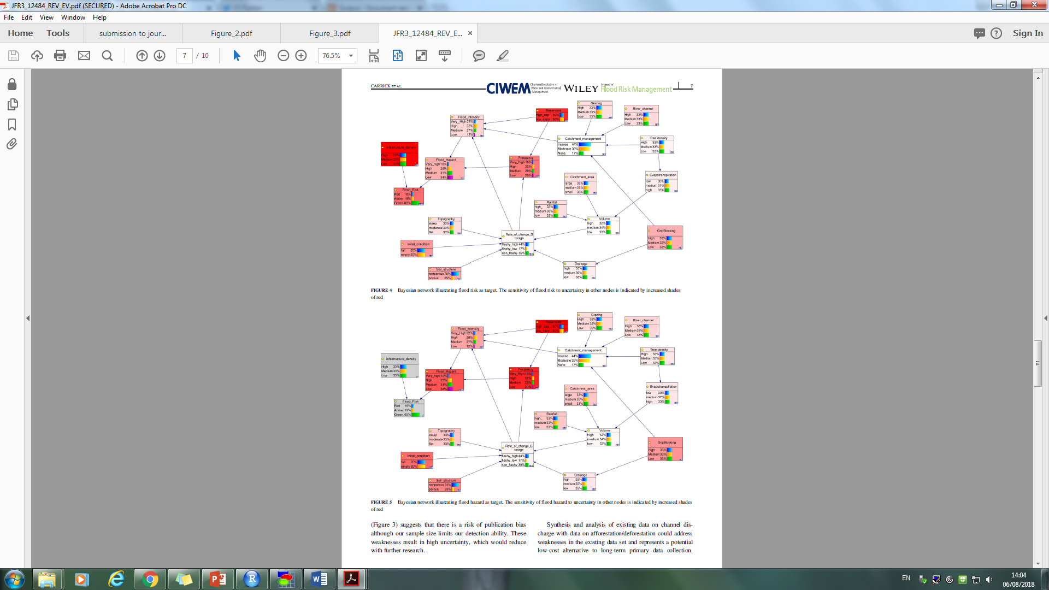
Is planting trees the solution to reducing flood risks?
Carrack, J. et al. (2018) Journal of Flood Risk Management

Slide 107
Good research updates our belief about evidence
Strength of evidence
Risk of bias
Precision
Inconsistency
Publication bias
Directness
Stewart G, Higgins J, Schunneman H, Meader N. (2015) The use of Bayesian Networks to assess the quality of evidence from research synthesis. PLoS ONE 10(4)

Slide 108
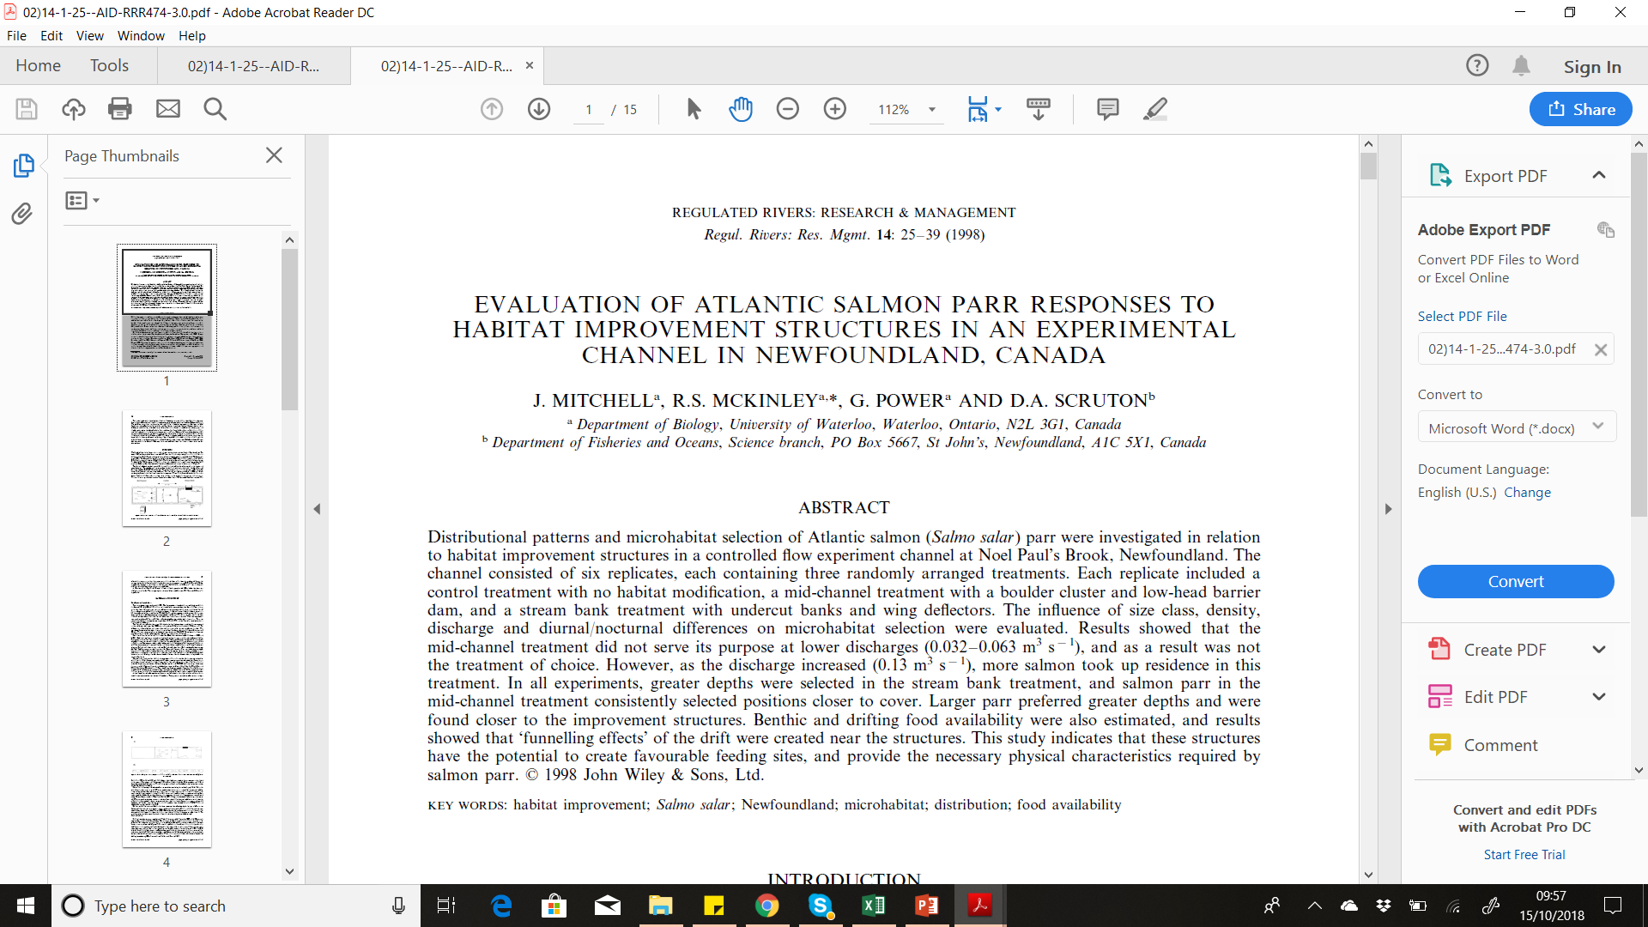
A real example of researcher degrees of freedom

